Slide 1
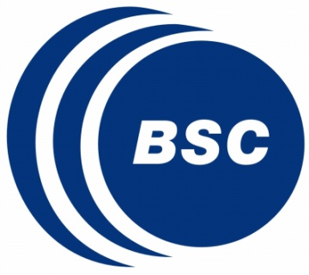
Efficient Routing Mechanisms for Dragonfly Networks
Marina García
Enrique Vallejo
Ramón Beivide
Miguel Odriozola
Mateo Valero
International Conference on Parallel Processing – Oct’2013

Slide 2
Index
Introduction
Introduction to the Dragonfly
Adaptive routing in Dragonflies
Alternative routing mechanisms
RLM: Restricted local misrouting
OLM: Opportunistic local misrouting
Evaluation
Conclusions and future work

Slide 3
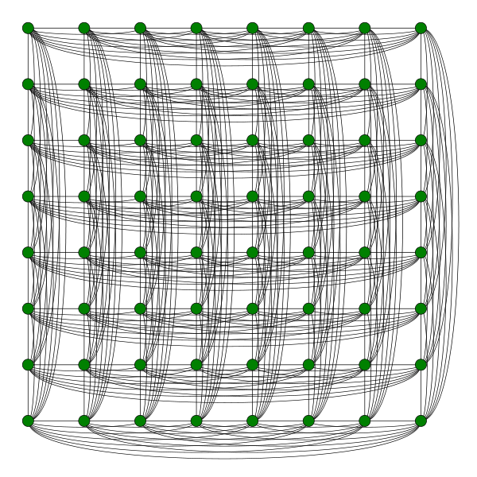
1. Introduction 1.1 Motivation
System networks for exascale will require low power and latency
This implies: low diameter and average distance
Traditional HPC networks employ low-radix routers (few ports)
3D or 5D torus in IBM BlueGene, 3D Torus in Cray XE-series
High-radix routers are the norm today [1]
Concentration: multiple computing nodes/router, trunking
Both in traditional datacenter and HPC networks
Frequent direct networks recently proposed for high-radix routers:
Flattened Butterfly
(Hamming graph, rook’s graph, …) Kim, ISCA’07
All-to-all topology (complete graph)
Dragonfly
(2-level direct network…)
Kim, ISCA’08
[1] Kim et al, “Microarchitecture of a high-radix router,” ISCA’05

Slide 4
1.1 Motivation: datacenter fat tree (folded clos) vs dragonfly
Differences between a traditional datacenter network and a Dragonfly network
Tree
Dragonfly
“pod”
2 main variations:
· Fat-tree: faster links in higher levels
· Folded clos: parallel switches in higher levels

Slide 5
1.1 Motivation: datacenter fat tree (folded clos) vs dragonfly
Dragonfly: Direct network, no transit routers
Connect the routers in a group (pod) by direct links
Connect the different groups by direct links between certain routers
What’s good?
Less cost: No transit switches, less and shorter links
Only inter-group links need to be optical
Less energy: Lower # of hops (diameter 3)
What’s bad?
Deadlock: cyclic dependencies can appear in the network
Solution: Deadlock-free routing mechanism required
Congestion: A single link (or a few of them) between groups, which can easily saturate
Congestion appears in both local or global links.
Solution: non-minimal adaptive routing to avoid congested links
Local misrouting within groups (2 local hops instead of 1)
Global misrouting between groups (visit an intermediate group in transit).

Slide 6
2. Introduction to Dragonfly networks
Destination group i+N
Minimal Routing
Longest path: 3 hops
local – global – local
Deadlock avoidance:
3 logical VCs [2]
VC0 - VC1 - VC2
2 physical VCs per local port + 1 physical VC per global port
Good performance under UN traffic
Saturation of the global link with adversarial traffic ADV+N
[2] K. Gunther, “Prevention of deadlocks in packet-switched data transport systems,” Trans. Communications 1981.
Source group i
Notes:
The diameter of a dragonfly topology is 3; that is, any minimal path between 2 nodes will employ at most 3 hops: 1 local hop from the source router to the router in the source group connected to the destination group, 1 global hop to the destination group, and finally another local hop to the router connected to the destination node.
Dragonfly topology induces the appearence of cycles. Former proposal rely in the use of virtual channels viseted in an predefined order to avoid dealock.
For minimal routing, 2 would be needed to avoid deadlock in a dragonfly.
Minimal routing provides good performance under uniform traffic patterns. However, under adversarial traffic paterns, the saturation of certain global links can be common

Slide 7
2. Introduction to Dragonfly networks
Valiant Routing [3]
Also “global misrouting”
Selects a andom intermediate group
Balances use of links
Doubles latency
Halves max. throughput under Uniform traffic
Longest path 5 hops:
local – global – local – global – local
Deadlock avoidance:
3 VCs per local port + 2 VCs per global port
[3] L. Valiant, “A scheme for fast parallel communication," SIAM journal on com-
puting, vol. 11, p. 350, 1982.
Notes:
To balance the use of global links under adversarial traffic patterns, nonminimal routing can be used.
With Valiant routing, an intermediate group is chosen randomly among those in the network to misroute the traffic. The packet is first sent minimally to that intermadiated group, and finally it is sent minimally to the destination node.
The saturated link is avoided. However, the longest path is 5 hops which doubles latency and halves throughput.
In this case, 3VC’s per local port a 2VC’s per global port would be needed to avoid deadlock

Slide 8
2. Introduction to Dragonfly networks
Adaptive Routing
Dynamically chooses between minimal and non-minimal routing.
Relies on the information about the state of the network
Source routing → Congested global queues can be in other routers
Piggybacking Routing (PB) [4]
Each router flags if a global queue is congested
Broadcast information about queues
Remote information
Chooses between minimal and Valiant
Source routing
Global
MIN
Global
VAL
Congestion
Router
Router
Busy
Free
Source
SOURCE
GROUP
Router
8
[4] Jiang, Kim, Dally. Indirect adaptive routing on large scale interconnection networks. ISCA '09.
Notes:
- Adaptive routing relies in the state of the network to decide between minimal and non-minimal routing maximizing performance
As source routing takes that decision at injection time, the information about congested global queues could be not available at the source router
With PiggyBacking routing, each router flags if a global queue is congested or not. Then, this information is broadcast to the neighbor nodes.
It chooses at injection time between minimal or valiant routing taking into account that remote information

Slide 9
3.1. Motivation: Local misrouting
Global links are the main bottleneck under adversarial traffic
The saturation of local links also limits the performance
Reduces max. throughput to 1/h. For h=16, Th ≤ 0.0624 phits/c (6,24%)
Occurs with intra- (left) and inter- (right) group traffic
Near-Neighbor traffic pattern: A single local link connects source and destination node → Saturation
Pathological problem when using Valiant routing with adversarial traffic
R_{in}
R_{out}
Notes:
Until now glbal links have been assumed as the only potential bottleneck in dragonfly interconnection networks
In this work we study the saturation of the local links. It is another possible bottleneck in dragonfly interconnection networks that can reduce performance to 1/h. For example for a dragonfly with parameter H=16 that would mean a maximum throughput lower than 7%
There are 2 possible causes in the saturation of the local links.
the first one is the intra group communication. Neighbor nodes communication traffic patterns are very common. In this case every node in this router sends traffic to the nodes in this neighbor router. There is only oone local link connectin both router, which would saturate.

Slide 10
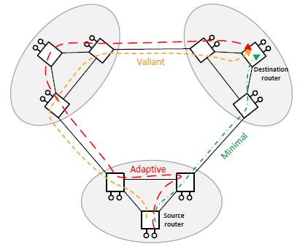
3.2 In-transit Misrouting
Minimal local hop
“Local misrouting” avoids saturated local links
Send packets to a different node within the group (non-minimal local hop), then to the destination (minimal local hop)
Longest path: 8 hops
local – local – global – local – local – global – local – local
Deadlock avoidance:
Distance-based mechanisms (PAR-6/2): 6 VCs per local port + 2 VC per global port
Our base mechanism, but too costly!
OFAR [5] supports local and global misrouting without VCs.
Separate escape subnetwork to prevent deadlock
Problems: congestion and unbounded paths
Non-minimal local hop
[5] M. García et al, “On-the-fly adaptive routing in high-radix hierarchical networks,” ICPP’12
Notes:
Our mechanism OFAR decides to route minimal or not-minimally on each hop to avoid network congestion.
When traffic is internal to a group only local misrouting is allowed, when traffic is external to the group, both local and global misrouting are allowed
It avoids saturation of the local links by enabling local misrouting.
OFAR-L model does not allow local misrouting. This is used to dissect the specific mechanisms of using local msrouting in the mechanism
With OFAR 6 virtual channels per local port and 2 per global port to avoid deadlock.

Slide 11
Index
Introduction
Introduction to the Dragonfly
Adaptive routing in Dragonflies
Alternative routing mechanisms
RLM: Restricted local misrouting
OLM: Opportunistic local misrouting
Evaluation
Conclusions and future work

Slide 12
2.1. RLM: Restricted Local Misrouting
Restricted Local Misrouting (RLM) is a routing mechanism which requires 3 VCs in local channels and 2 VCs in global ones (denoted 3/2 VCs)
like Piggybaking.
3/2 VCs are enough to prevent cycles between different groups
But cyclic dependencies can arise within a group if the same VC is reused in the 2-hop local misrouting
Key idea:
Use the same VC index for the 2 local hops in a single group
Forbid certain 2-hop routes to prevent cyclic dependencies
Deadlock-free by construction
Works with any flow control mechanism (wormhole included)
IBM PERCS [6] employs wormhole switching!
RLM restricts path diversity, what reduces max. throughput.
[6] B. Arimilli, et al., “The PERCS high-performance Interconnect”, HOTI’10

Slide 13
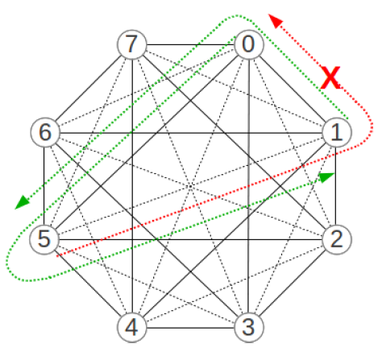
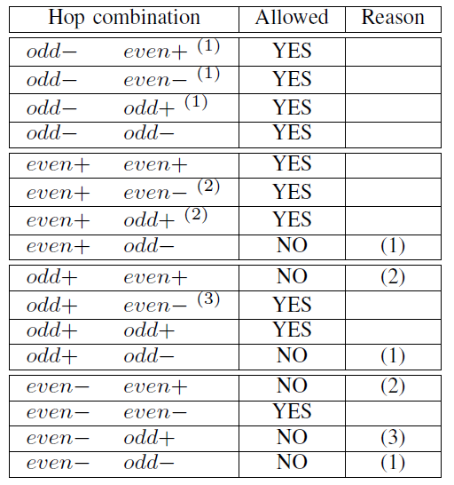
2.1. RLM: Restricted Local Misrouting
Implementation based on parity and sign of each link.
Parity of a link: even(odd) if both nodes have the same (different) parity
Sign: Positive + if destination index > source index
even-, odd-
Allowed 2-hop paths from 5 to 0: 5-2-0 and 5-4-0 (odd-, even-) 5-6-0 (odd+, even-)

Slide 14
2.2. OLM: Opportunistic Local Misrouting
Oppportunistic Local Misrouting (OLM): Routing mechanism using 3/2 VCs with a modified distance-based deadlock avoidance mechanism:
Minimal routing and global misrouting → Increase VC index
Local misrouting (opportunistic) → Reuse or decrease VC index
Deadlock freedom: Local misrouting is opportunistic: if the packet cannot advance, there is always a safe “escape” path to the destination using increasing order of VCs: the one without local misrouting
Why it does work? The “safe path” always exists, due to the topology of the network
Decreasing the index on a local misrouting guarantees that a path with increasing order in the VC index exists, since all routers (but one) in a group have the same distance to the destination group.

Slide 15
2.2. OLM: Opportunistic Local Misrouting
VC indexes: VC₁ – VC₂ – VC₃ – VC₄ – VC₅
Minimal routing
2
3
Interm. group
Destination group
1
VC₃
VC₄
VC₅
VC₄
Global misrouting
VC₁
VC₃
5
VC₃
3
4
1
2
VC₂
VC₂
OLM
VC₁
VC₂
4
5
2
3
1
1
1
VC₁
VC₁
Source group

Slide 16
Comparison chart
 | Piggy- backing [4] | OFAR [5] | PAR-6/2 | RLM | OLM
Local misrouting
Congestion-prone (escape network) | NO | YES | NO | NO | NO
VCs in local ports (cost) | 3 | Any | 6 | 3 | 3
Routing freedom In local misrout. | None | Max. | Max | Just Enough | Max
Wormhole support
[4] Jiang, Kim, Dally. Indirect adaptive routing on large scale interconnection networks. ISCA '09.
[5] M. García et al, “On-the-fly adaptive routing in high-radix hierarchical networks,” ICPP’12.

Slide 17
Index
Introduction
Introduction to the Dragonfly
Adaptive routing in Dragonflies
Alternative routing mechanisms
RLM: Restricted local misrouting
OLM: Opportunistic local misrouting
Evaluation
Conclusions and future work

Slide 18
3. Evaluation 3.1 Simulation parameters
Simulated network:
2.064 routers with 31 ports/router
129 groups of 16 routers each, 16x8=128 servers per group
16.512 servers in the system
Simple, in-house simulator:
Input-FIFO router model
Virtual cut-through or wormhole switching
No speedup, single-cycle router
Synthetic traffic: uniform or worst-case patterns
Link latencies and queue sizes:
10 cycles in local links, 32 phits per VC
100 cycles in global links, 256 phits per VC

Slide 19
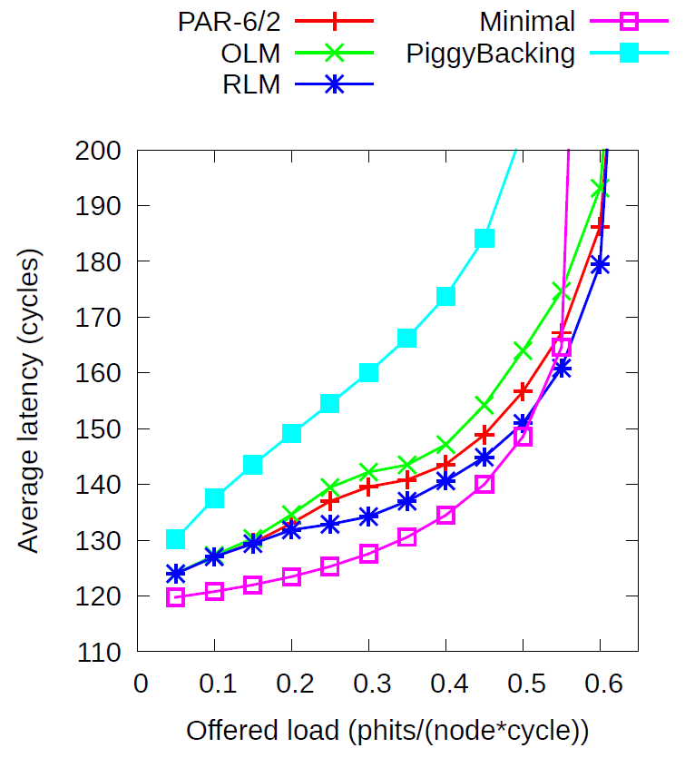
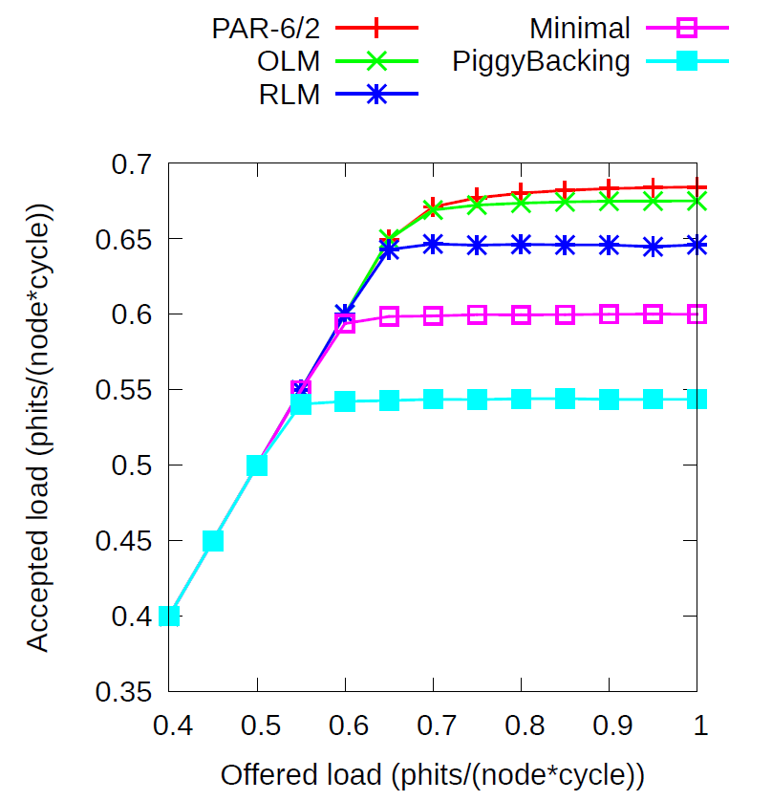
3. Evaluation 3.2. Latency and throughput
Performance – uniform traffic

Slide 20
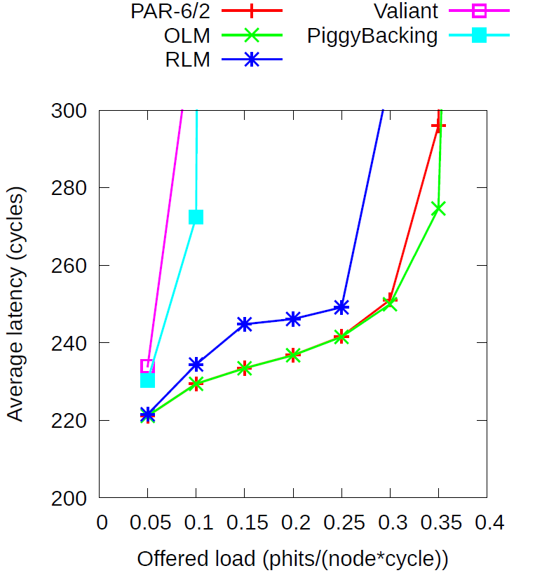
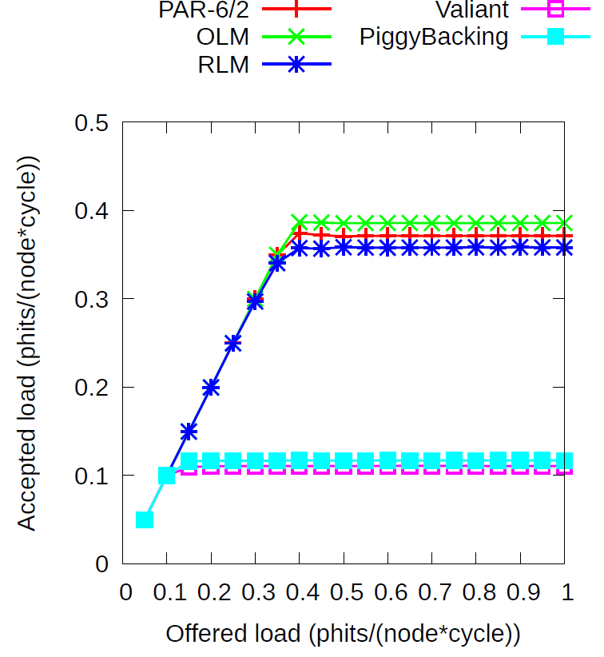
3. Evaluation 3.2. Latency and throughput
Performance – adversarial ADV+6 traffic

Slide 21
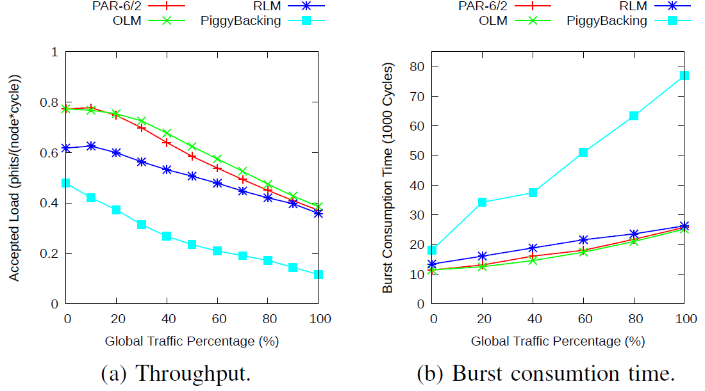
3. Evaluation 3.2. Variable local & global misrouting
Intra-group adversarial traffic
Inter-group adversarial traffic

Slide 22
4. Conclusions
We introduce two low-cost deadlock-free routing mechanisms for dragonfly networks with local misrouting support:
OLM is recommended in the general case
RLM is suitable for wormhole networks
Implementation cost is minimized
Considering the 3/2 VCs required for global misrouting
Implementations are simple and affordable
We have patented the OLM mechanism
Willing to license it! ☺

Slide 23
Efficient Routing Mechanisms for Dragonfly Networks
Marina García
Enrique Vallejo
Ramón Beivide
Miguel Odriozola
Mateo Valero
International Conference on Parallel Processing – Oct’2013

